Slide 1

THEORY OF MECHANISMS AND MACHINES (Chapter one: Introduction)
Prepared by
Bipin Tiwari
Asst. Lecturer
Thapathali Campus, IOE, TU

Slide 2
Chapter over view Introduction (2 hrs)
Mechanisms and machine : Basic definitions
Mechanism configurations:
Links
Joints
Kinematic Chains
Inversions of mechanism
Mobility or Degree of freedom: Grubler’s criterion
Mechanisms and Structures

Slide 3
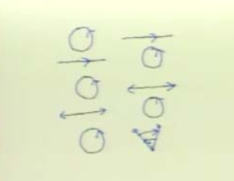
Machines and Mechanisms
Machine
A device for transferring and transforming motion and force (power) from source to a load.
The means is through mechanisms.
Input: Source and Output: Load

Slide 4
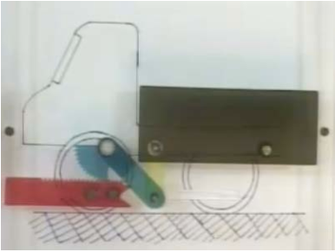
Contd…
Mechanism:
It is a combination of rigid bodies capable of relative motion.

Slide 5
CONTD...
A useful working definition of a mechanism is “A system of elements arranged to transmit motion in a predetermined fashion.”
On the other hand, a machine is “A system of elements arranged to transmit motion and energy in a predetermined fashion.”

Slide 6
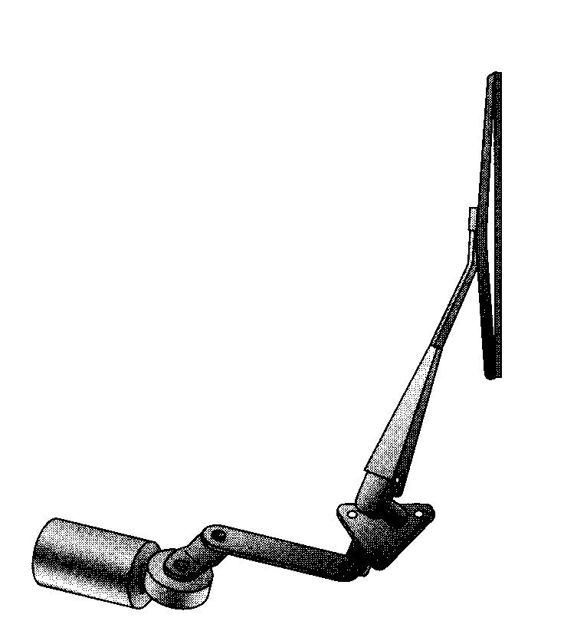
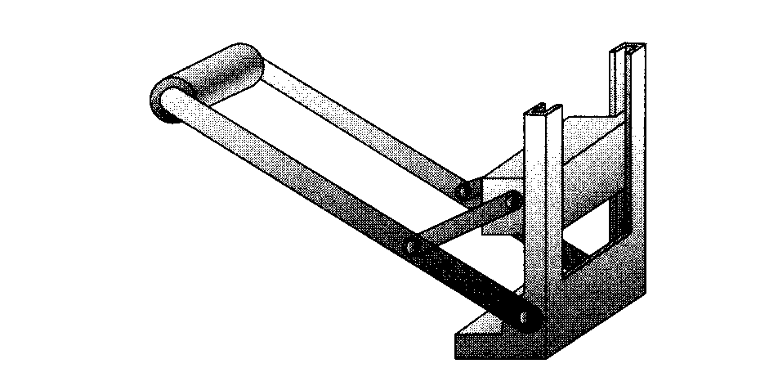
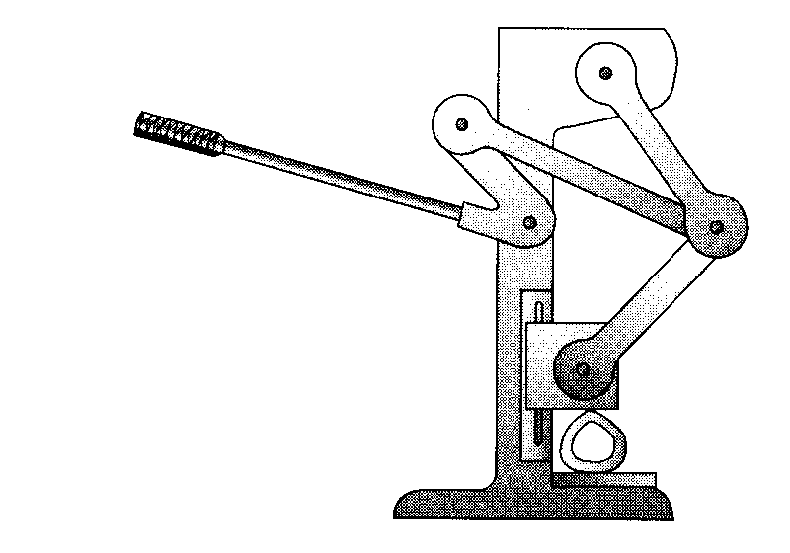
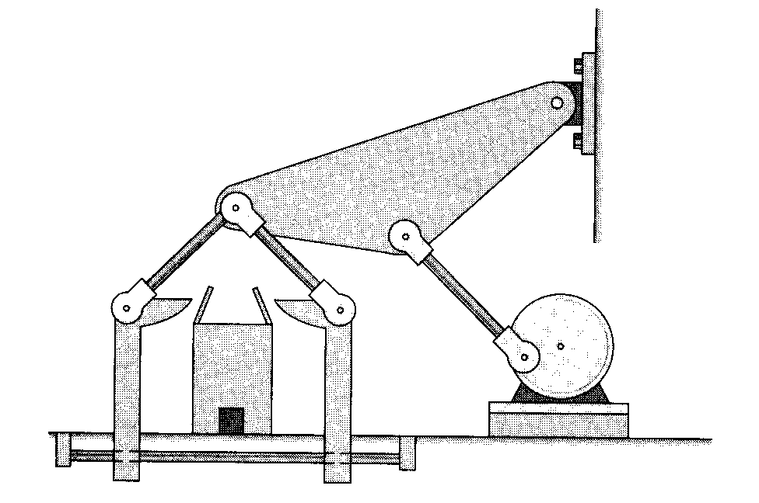
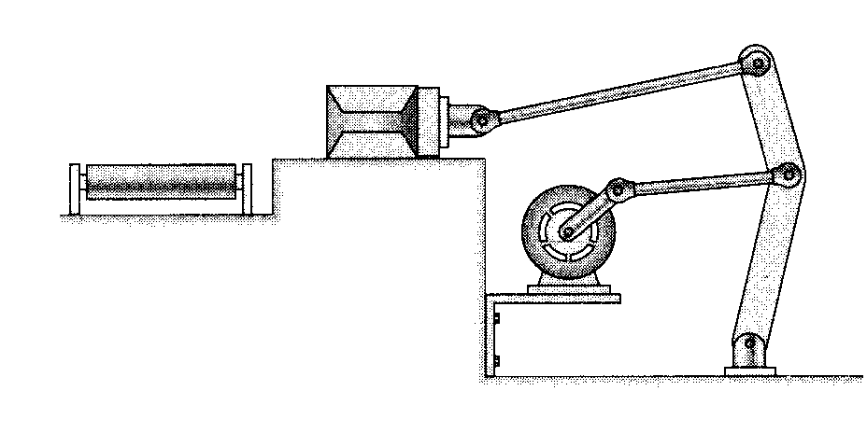
CONTD...
Examples on mechanism
Rear-window wiper
Can crusher
Device to close the top flap of boxes
Simple press
Moves packages from an assembly bench to a conveyor

Slide 7
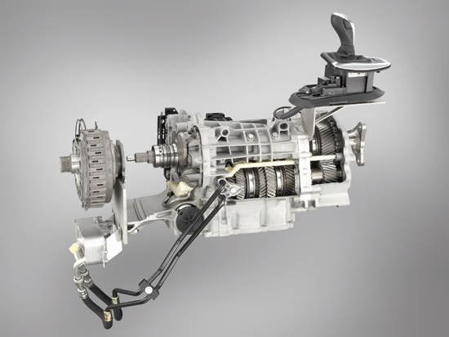

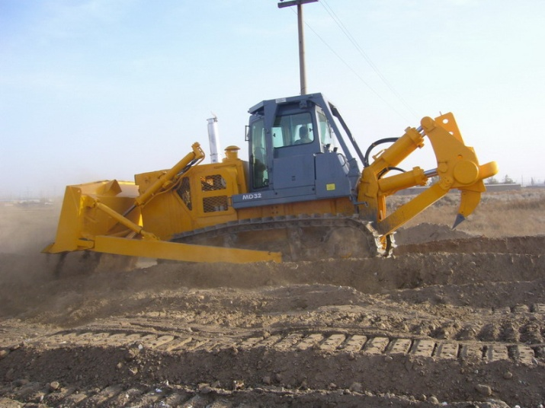
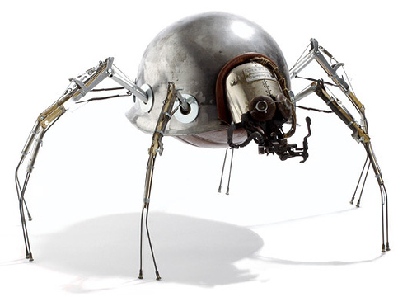
CONTD...
Example on machines
Automatic Transmission
Food Blender
Spider Robot
Bull dozer

Slide 8
Theory of Machines and mechanism
It may be defined as that branch of Engineering-science, which deals with the study of relative motion between the various parts of a machine, and forces which act on them.
The knowledge of this subject is very essential for an engineer in designing the various parts of a machine or to develop mechanism.

Slide 9
CONTD…
It may be sub-divided into the following four branches :
1. Kinematics
It deals with the relative motion between the various parts of the machines.
2. Dynamics
It deals with the forces and their effects, while acting upon the machine parts in motion.
3. Kinetics
It deals with the inertia forces which arise from the combined effect of the mass and motion of the machine parts.
4. Statics
It deals with the forces and their effects while the machine parts are at rest. The mass of the parts is assumed to be negligible.

Slide 10
Kinematics of motion
IT deals with the geometric aspects of motion (Constraints) without considering any forces.
In other words, kinematics deal with the
geometry of motion and concepts like displacement, velocity and acceleration considered as functions of time.
Plane Motion
When the motion of a body is confined to only one plane, the motion is said to be plane motion.
The plane motion may be either rectilinear or curvilinear.

Slide 11
CONTD…
Rectilinear Motion
It is the simplest type of motion and is along a straight line path. Such a motion is also known as translation motion.
Rectilinear Translation
Curvilinear Motion
It is the motion along a curved path. Such a motion, when confined to one plane, is called plane curvilinear motion.
Curvilinear Translation
Curvilinear Rotation
When all the particles of a body travel in concentric circular paths of constant radii (about the axis of rotation perpendicular to the plane of motion) such as a pulley rotating about a fixed shaft or a shaft rotating about its own axis, then the motion is said to be a plane rotational motion.

Slide 12
Mechanism configurations
Link ( Kinematic element):
It is defined as a member or combination of members of a mechanism, connecting other members and having relative motion to them.
It is an (assumed) rigid body which possesses at least two nodes which are points for attachment to other links.

Slide 13
CONTD…
Joint (kinematic pairs):
It is a connection between two or more links (at their nodes), which allows some motion, or potential motion, between the connected links.
Kinematic chain:
An assemblage of links and joints, interconnected in a way to provide a controlled output motion in response to a supplied input motion.

Slide 14
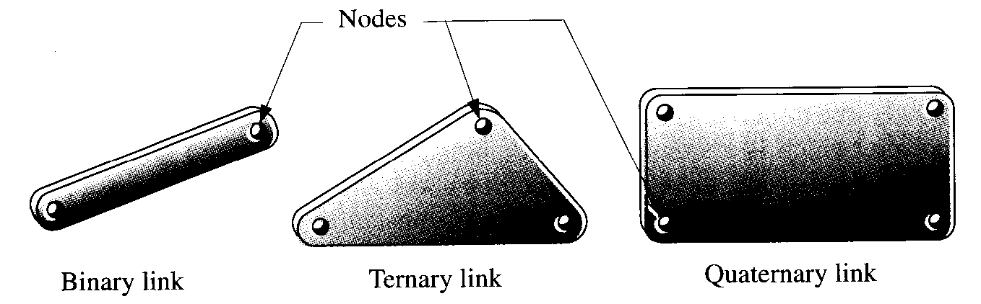
LINKS
Binary link - one with two nodes.
Ternary link - one with three nodes.
Quaternary link - one with four nodes.
Pentagonals – one with five nodes.
Hexagonals – one with six nodes

Slide 15
JOINTS
Joints can be classified on following basis
Type of Contact
Number of Degrees of Freedom allowed at the joint
Type of Physical Closure of the Joint
Order of Joints

Slide 16
JOINTS
1. Type of Contact
Lower Pair
If joints have surface or area contact, they are called Lower pair (as with a pin surrounded by a hole).
e.g, Nut turning on a screw, shaft rotating in a bearing, etc
Higher Pairs
If joints have point or line contact, they are called Higher pair.
e.g, cam and follower, Tooth Gears, etc
Wrapping Pairs
Belt and pulley, Chain and Sprocket
The main practical advantage of lower pairs over higher pairs is their better ability to trap lubricant between their enveloping surfaces.

Slide 17
JOINTS
2. Number of Degrees of Freedom allowed at the joint
The number of independent co-ordinates that are needed to describe the relative movement permitted in a kinematic pair.
One freedom joints (Full Joints): eg. a rotating pin joint (R) and a translating slider Joint (P).
Two freedom joints (Half Joints): eg. link against plane and a pin in slot.
Three freedom joints: eg. a spherical, or ball-and-socket joints.

Slide 18
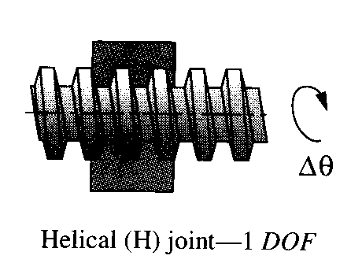
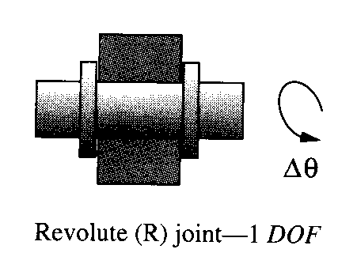
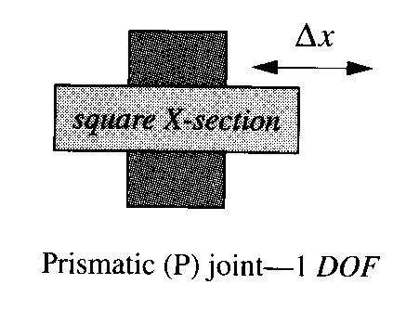
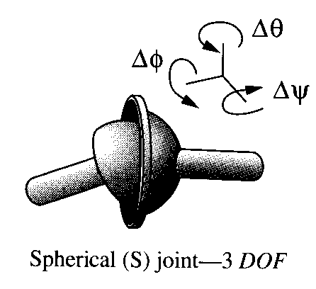
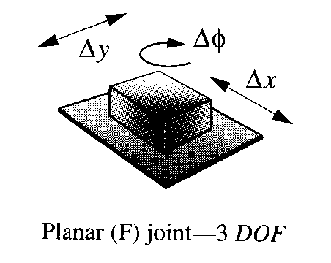
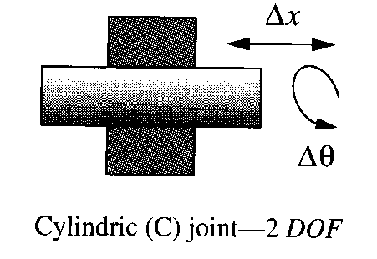
JOINTS
The six possible lower pairs

Slide 19
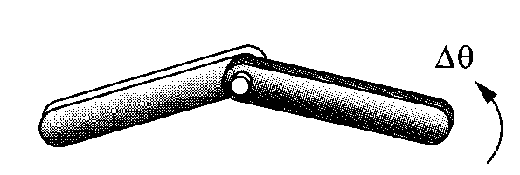
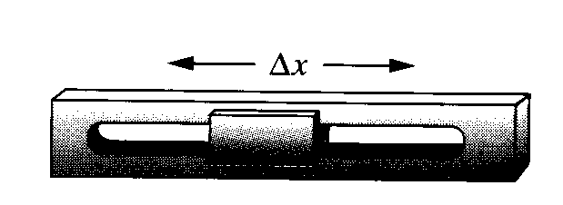



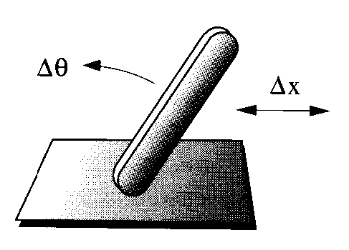
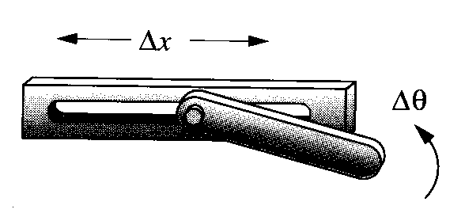



JOINTS

Slide 20
JOINTS
3. Type of Physical Closure of the Joint
A form-closed joint is kept together or closed by its geometry. A pin in a hole or a slider in a two-sided slot are form closed.
A force-closed joint, such as a pin in a half-bearing or a slider on a surface, requires some external force to keep it together or closed. This force could be supplied by gravity, a spring, or any external means.

Slide 21
JOINTS
4. Order of Joints
We can classify Joints by the order of joints as 1st order, 2nd order and so on.
Order is defined as the number of links joined minus one.
It takes two links to make a single joint; thus the simplest joint combination of two links has order one.
Joint order has significance in the proper determination of overall degree of freedom for the assembly.

Slide 22
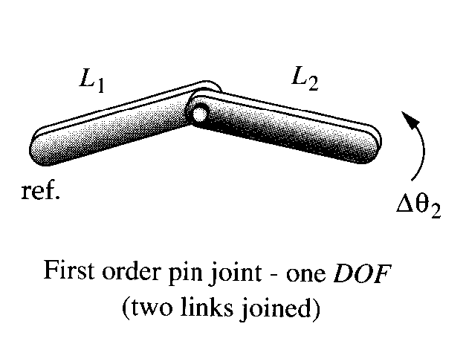
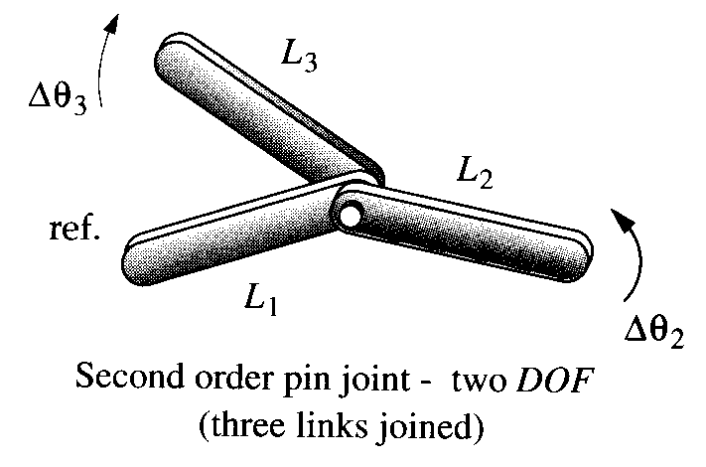
JOINTS

Slide 23
KINEMATIC CHAINS
A kinematic chain is defined as:
An assemblage of links and joints, interconnected in a way to provide a controlled output motion in response to a supplied input motion.
A mechanism is defined as:
A kinematic chain in which at least one link has been "grounded," or attached, to the frame of reference (which itself may be in motion).
A machine is defined as:
A combination of resistant bodies arranged to compel the mechanical forces of nature to do work accompanied by determinate motions.

Slide 24
CONTD…
The most important kinematic chains are those which consist of four lower pairs, each pair being a sliding pair or a turning pair.
The following three types of kinematic chains with four lower pairs are important.
1. Four bar chain or quadric cyclic chain
2. Single slider crank chain
3. Double slider crank chain

Slide 25
Inversion of Mechanism
When one of links is fixed in a kinematic chain, it is called a mechanism.
The method of obtaining different mechanisms by fixing different links in a kinematic chain, is known as inversion of the mechanism.
It may be noted that the relative motions between the various links is not changed in any manner through the process of inversion, but their absolute motions (those measured with respect to the fixed link) may be changed drastically.

Slide 26
CONTD…
The part of a mechanism which initially moves with respect to the frame or fixed link is called driver and that part of the mechanism to which motion is transmitted is called follower.
Most of the mechanisms are reversible, so that same link can play the role of a driver and follower at different times.
For example, in a reciprocating steam engine, the piston is the driver and flywheel is a follower while in a reciprocating air compressor, the flywheel is a driver.

Slide 27
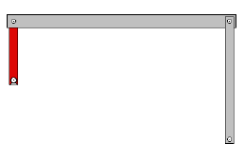
CONTD…
Ground
Any link or links that are fixed with respect to the reference frame
Crank
A link which makes a complete
revolution and is pivoted to ground
Rocker
A link which has oscillatory (back and forth) rotation and pivoted to ground
Coupler (connecting Rod)
A link which has complex motion and is pivoted to ground
CR
C
R

Slide 28
Degree of Freedom
Degree of freedom (mobility M):
It is the number of inputs which need to be provided in order to create a predictable output or the number of independent coordinates required to define its position.
Degree of Freedom in Planar Mechanisms
To determine the overall DOF of any mechanism, we must account for the number of links and joints, and for the interactions among them.

Slide 29
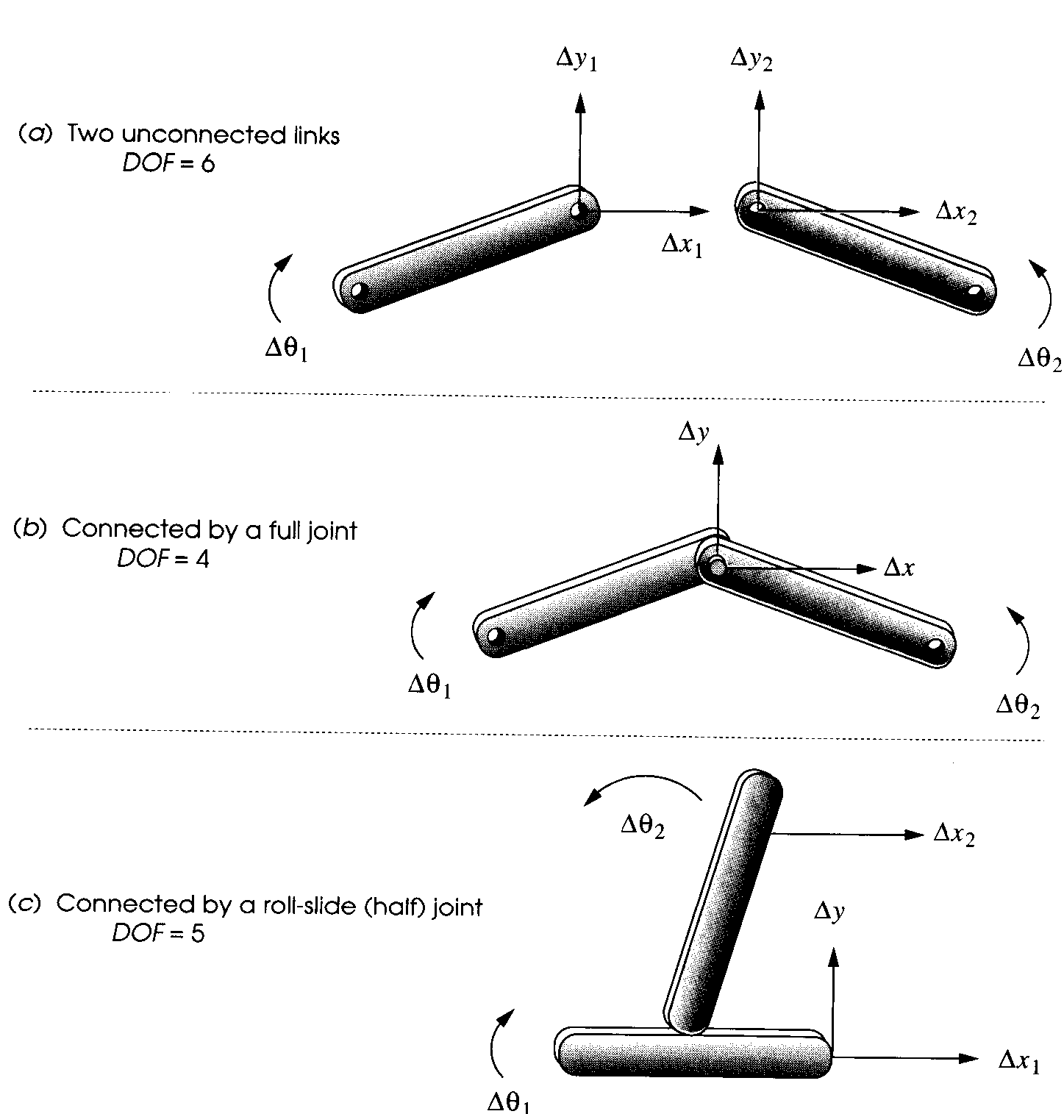
CONTD...

Slide 30
CONTD…
GRUBLER’S CRITERION :
Number of degrees of freedom of a mechanism is given by
F = 3(n-1)-2l-h.
Where,
F = Degrees of freedom
n = Number of links in the mechanism.
l = Number of lower pairs, which is obtained by counting the number of joints. If more than two links are joined together at any point, then, one additional lower pair is to be considered for every additional link.
h = Number of higher pairs

Slide 31
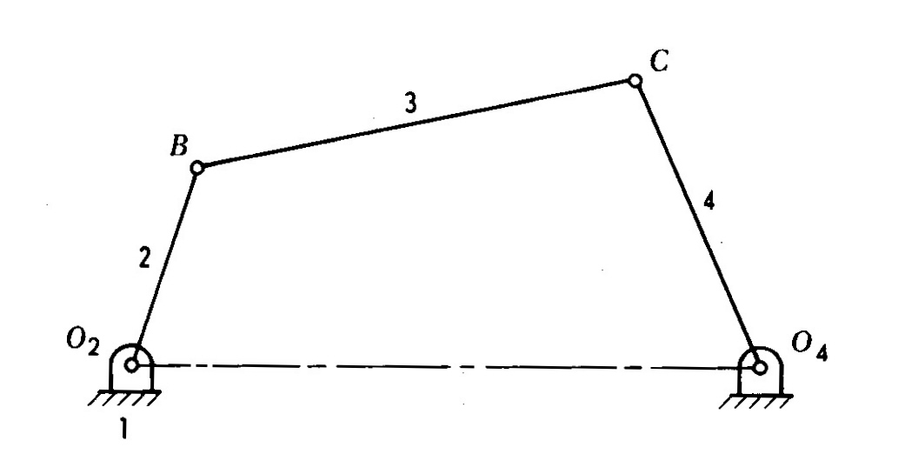
Contd…
1.

Slide 32
CONTD…
DOF: Example 1
F = 3(n-1)-2l-h
Here, n = 4, l = 4 & h = 0.
F = 3(4-1)-2(4) = 1
I.e., one input to any one link will result in definite motion of all the links.

Slide 33
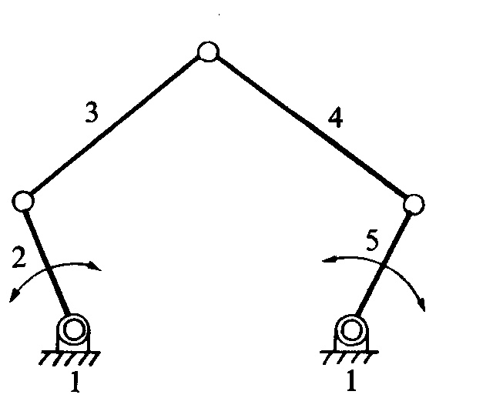
Contd…
2

Slide 34
CONTD…
Example 2
F = 3(n-1)-2l-h
Here, n = 5, l = 5 and h = 0.
F = 3(5-1)-2(5) = 2
I.e., two inputs to any two links are required to yield definite motions in all the links.

Slide 35
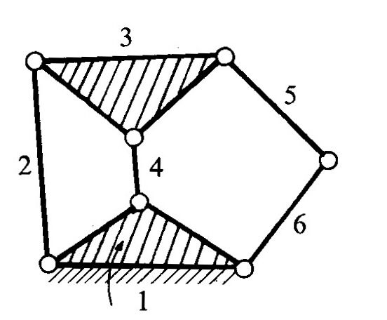
Contd..
3.

Slide 36
CONTD…
Example 3
F = 3(n-1)-2l-h
Here, n = 6, l = 7 and h = 0.
F = 3(6-1)-2(7) = 1
I.e., one input to any one link will result in definite motion of all the links.

Slide 37
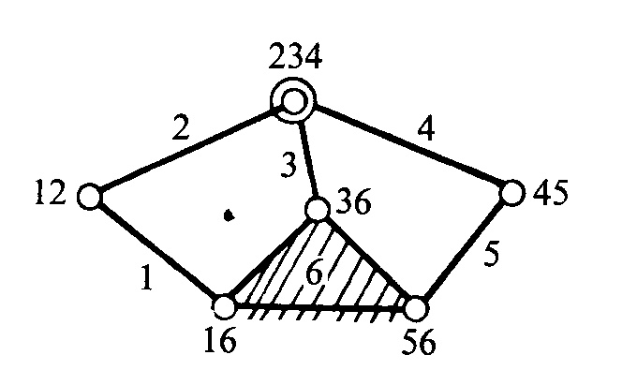
Contd…
4

Slide 38
CONTD…
Example 4
F = 3(n-1)-2l-h
Here, n = 6, l = 7 (at the intersection of 2, 3 and 4, two lower pairs are to be considered) and h = 0.
F = 3(6-1)-2(7) = 1

Slide 39
Mechanism and Structure
The degree of freedom of an assembly of links completely predicts its character.
There are only three possibilities.
If the DOF is positive, it will be a mechanism, and the links will have relative motion.
If the DOF is exactly zero, then it will be a structure, and no motion is possible.

Slide 40
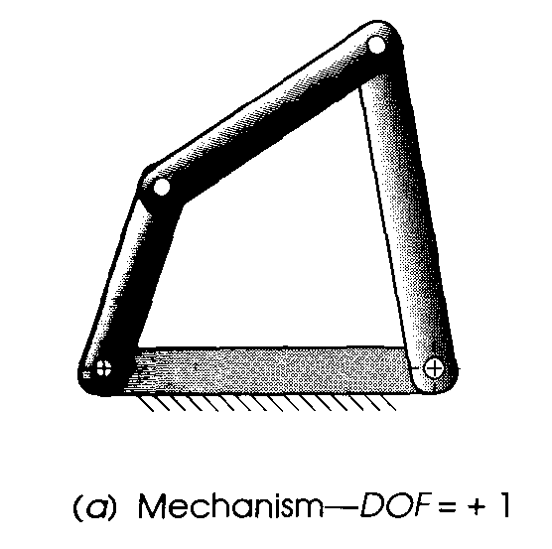
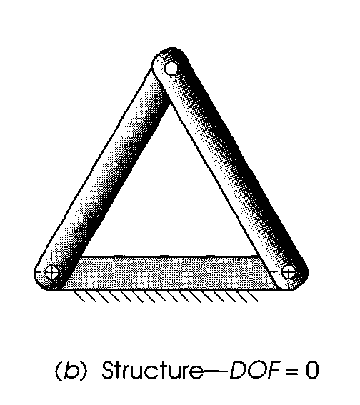
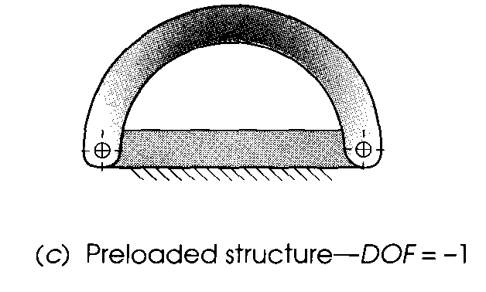
CONTD…
If the DOF is negative, then it is a preloaded structure, which means that no motion is possible and some stresses may also be present at the time of assembly.

Slide 41
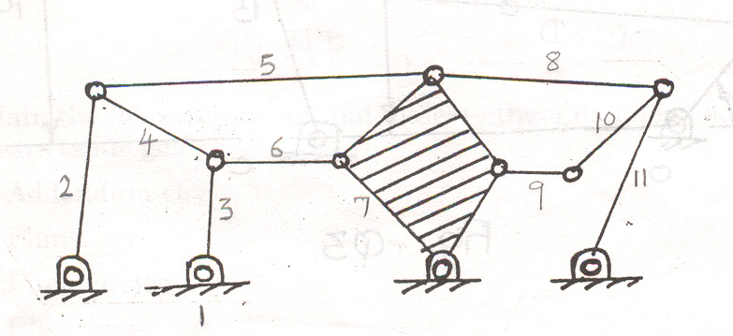
CONTD…
Example 5

Slide 42
Contd…
soln
F = 3(n-1)-2l-h
Here, n = 11, l = 15 (two lower pairs at the intersection of 3, 4, 6; 2, 4, 5; 5, 7, 8; 8, 10, 11) and h = 0.
F = 3(11-1)-2(15) = 0

Slide 43
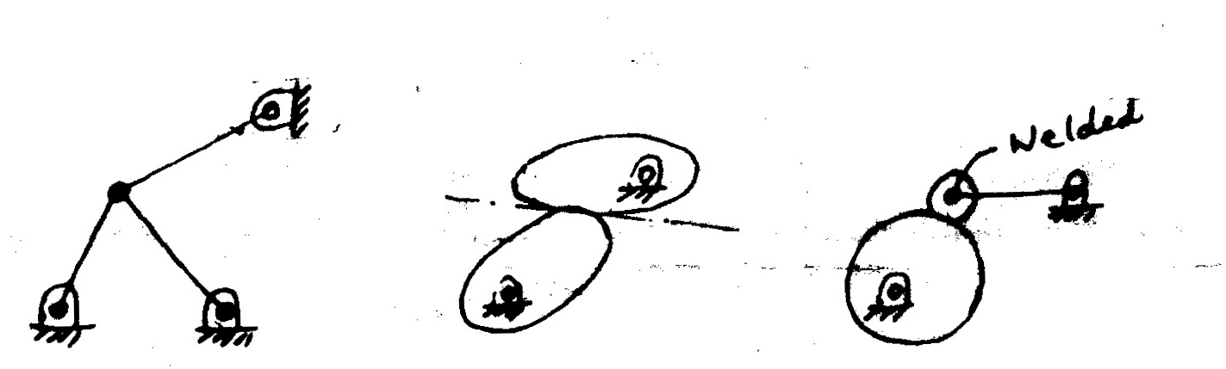
CONTD…
Example 6

Slide 44
Contd…
(a) F = 3(n-1)-2l-h Here, n = 4, l = 5 and h = 0. F = 3(4-1)-2(5) = -1 I.e., it is a structure | (b) F = 3(n-1)-2l-h Here, n = 3, l = 2 and h = 1. F = 3(3-1)-2(2)-1 = 1 | (c) F = 3(n-1)-2l-h Here, n = 3, l = 2 and h = 1. F = 3(3-1)-2(2)-1 = 1

Slide 45
THANK YOU

